Slide 1
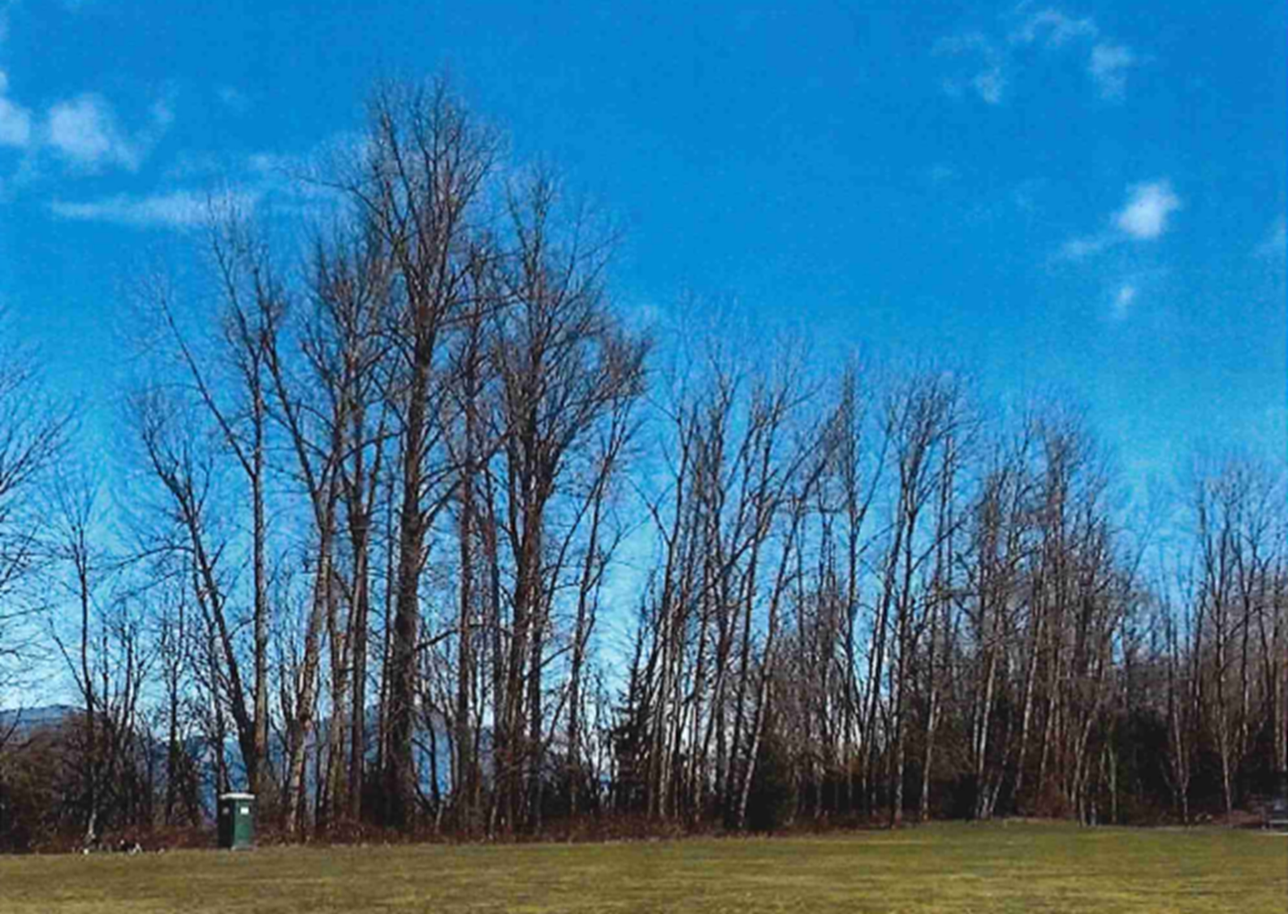
Temkwikwexel
During Temkwikwexel the trees, earth, and sky come alive again. One of the gifts we are thankful for during this time of year is the Cottonwood tree

Slide 2
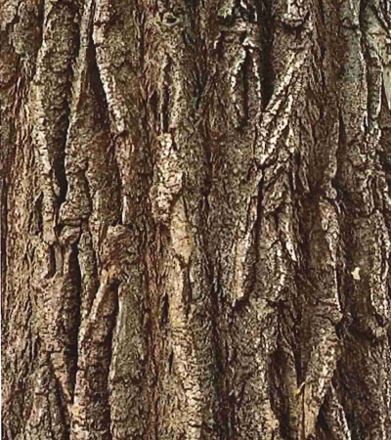
Cottonwood Bark

Slide 3
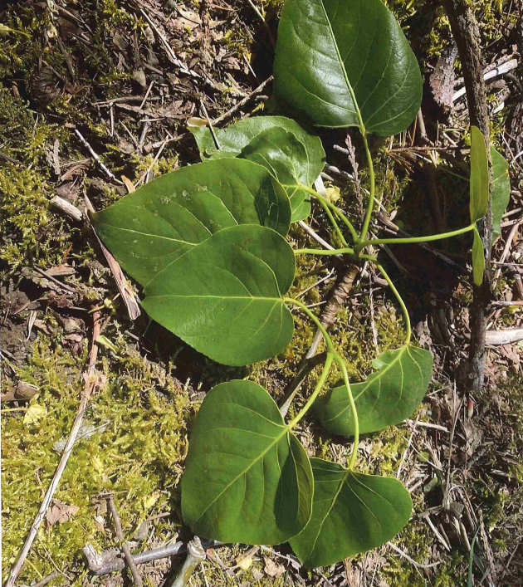
Cottonwood leaf

Slide 4
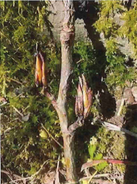
Cottonwood Bud

Slide 5
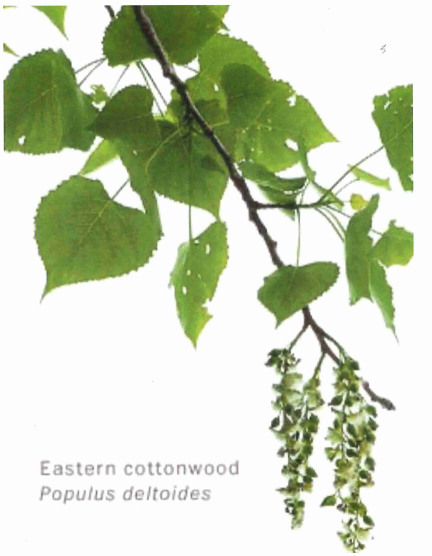
Cottonwood catkin

Slide 6
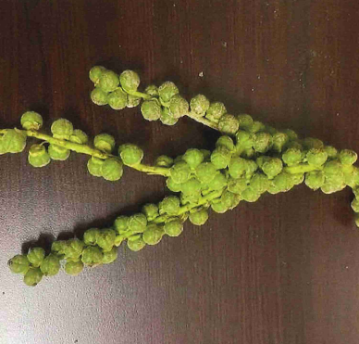
Cottonwood seed pod

Slide 7
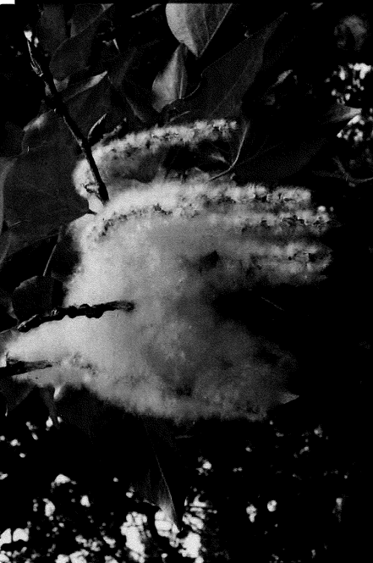
Cottonwood fluff

Slide 8
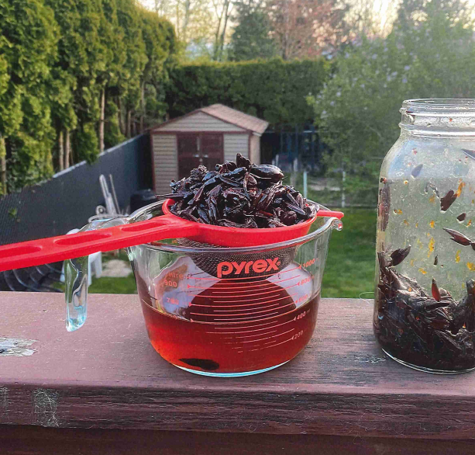
Cottonwood salve prep

Slide 9
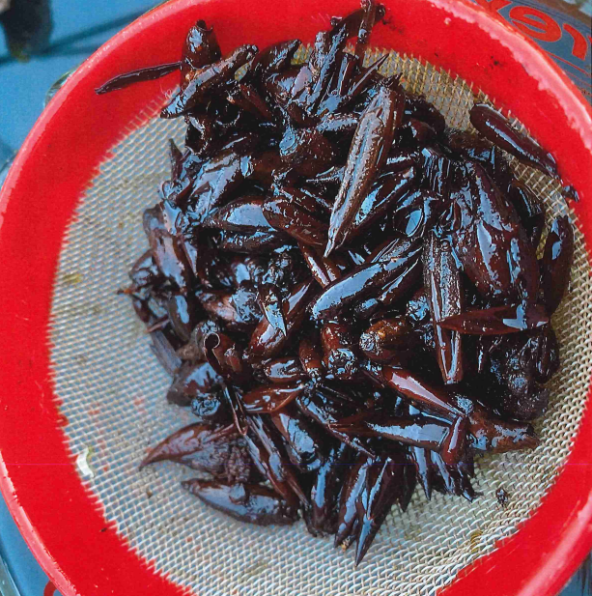
Strained cottonwood buds

Slide 10
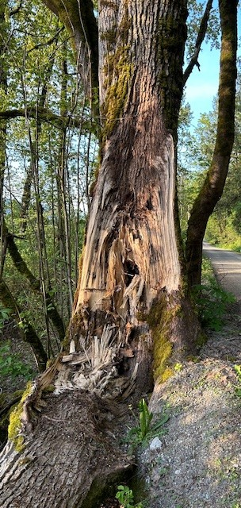
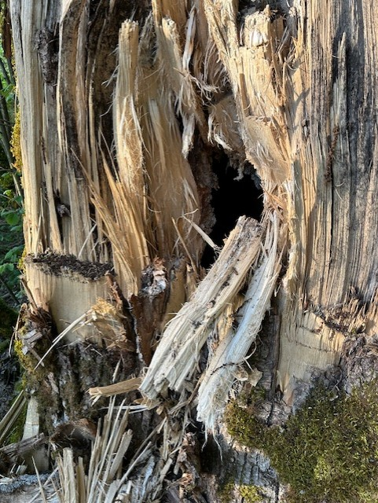
Cottonwood making room
Check out this cottonwood making room for another living thing.
Who do you think will make their home here?

Slide 11
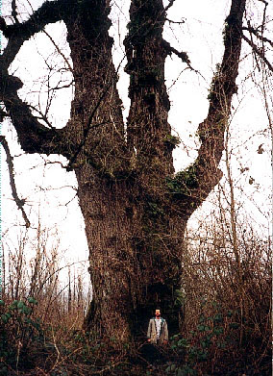
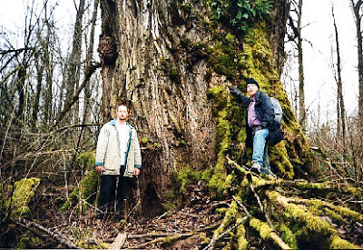
One of the largest cottonwoods is in our own backyard!
BC's current Black Cottonwood Champion Tree (BC Big Tree Registry) is found at the confluence of the Sumas and Fraser Rivers. This Island is called Skumalasph and is part of Skwah First Nation Territory near Deroche where the Sumas, Fraser and Nicomen Slough come together. The area has a long growing season, seasonal flooding, mild climate, and nutrient-rich soil from the salmon runs. This poplar is noted as the world's biggest poplar, and its measurements are indeed impressive:
Circumference: 11.92m/39.5ft
Height: 39.01 m/128 ft
Crown spread: 29.60 m/97ft
AFA Points: 626

Slide 12
References:
Colossal Coastal Cottonwoods. vancouverislandbigtrees.blogspot.com/2011/05/colossal-coastal-cottonwoods.html.
BC BigTree. “Top 30 | BC BigTree.” BC BigTree Website, 28 Feb. 2024, https://bigtrees.forestry.ubc.ca/bc-bigtree-registry/top-30/
Skwah First Nation. skwah.ca.

